Slide 1

MSEEQs
Midsemester Feedback
Please take the first 10 minutes of class to complete the MSEEQs for this course.
Spring 2025: Mon. Feb. 17 to Sun. Mar. 2 until 11:50 pm
Notes:
Wait outside the classroom because students will feel pressure if you are in the room.
“Mid-semester feedback is important to me because it helps me understand your experience/learning and make mid-course changes that can benefit you.”
“I want to hear from you whether your feedback is positive, neutral, or negative.”
Your responses are aggregated and anonymous.

Slide 2
SEEQs
End-of- semester Feedback
Please take the first 10 minutes of class to complete the SEEQs for this course.
Spring 2025: Mon. April. 14 to Sun. May 4 until 11:50 pm
Notes:
Wait outside the classroom because students will feel pressure if you are in the room.
“Mid-semester feedback is important to me because it helps me understand your experience/learning and make mid-course changes that can benefit you.”
“I want to hear from you whether your feedback is positive, neutral, or negative.”
“I will look for common themes and make decisions about potential changes.”
“We can also discuss strategies that can improve your learning.”

Slide 3
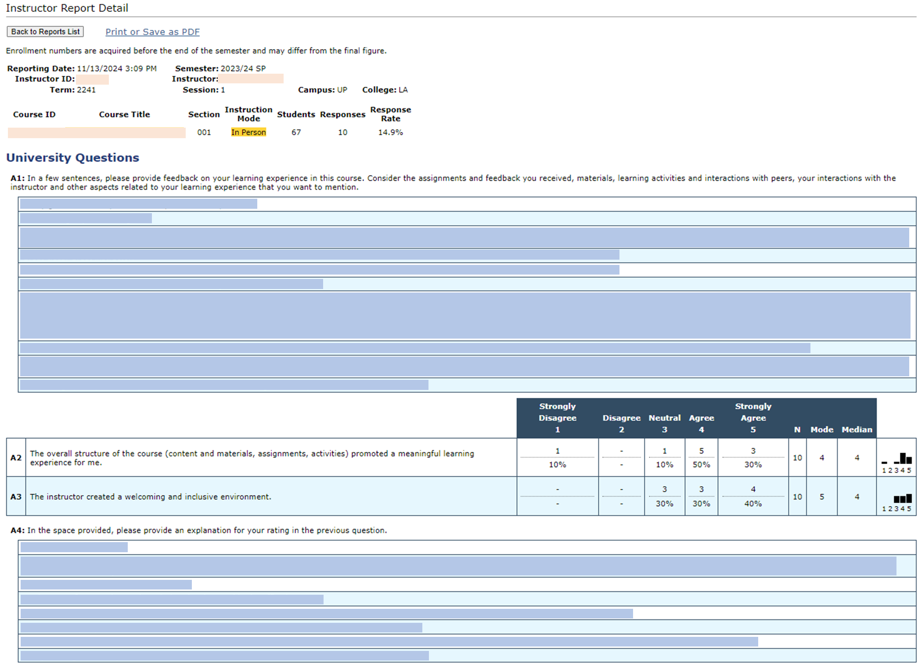
Notes:
Above is a screenshot of a real SEEQ Report, with the student feedback blocked out. Students may be relieved to see a report because it shows that their responses are aggregated and thus anonymous.

